Slide 1
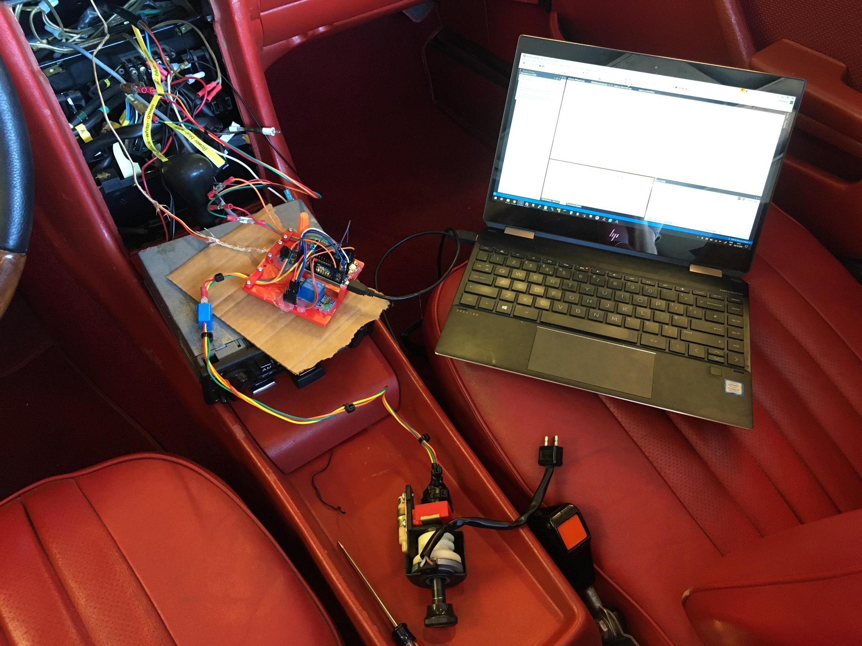
12V & compressor, blower control
Thermocouple
into evap
Prototype board
AC Control knob

